Slide 1
History of Diversity - Stability

Slide 2
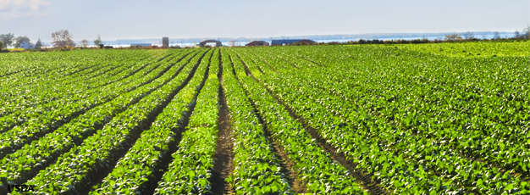
Early discussions of ‘stability’ (1950s)
Elton (1958) noted human-simplified ecosystems are less stable.
More pest outbreaks, larger population cycles, more invasions …
Complexity begets stability

Slide 3
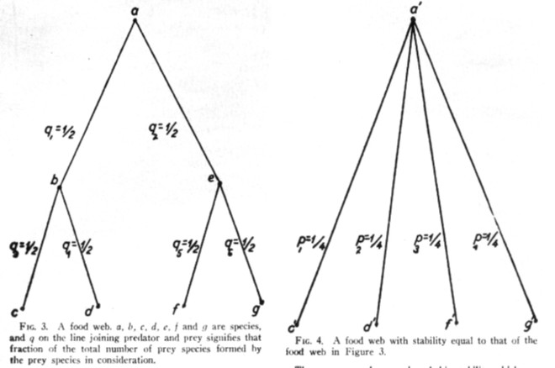
Early discussions of ‘stability’ (1950s)
MacArthur (1955) argued more energy pathways to consumers is less likely to fail.

Slide 4
Early work concluded:
Complexity (diversity) begets stability.

Slide 5
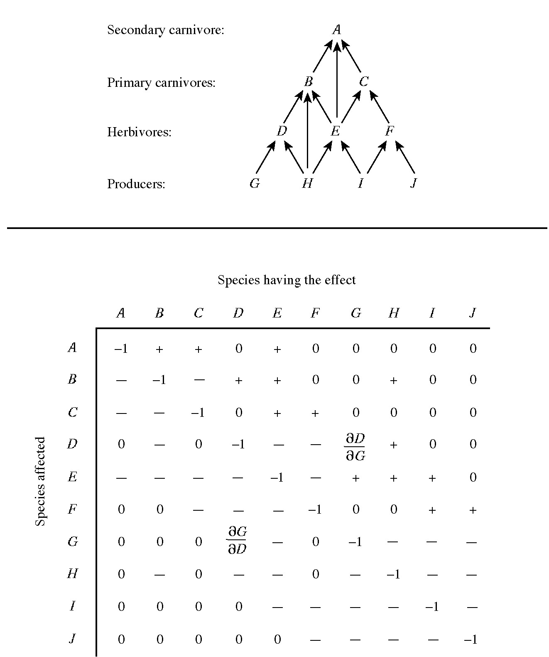
Theoretical discussions of stability (1970s and 1980s)
Assembling Jacobian matrices randomly (May 1974, Gardner & Ashby 1975 …) & measured stability, or persistence of species

Slide 6
Theoretical discussions of stability (1970s and 1980s)
Concluded that communities with more species, more connectance, and higher interaction strength tended to be less stable (all species did not persist).
Complexity begets instability

Slide 7
Further theoretical work (1980s)
More realistic theoretical (Jacobian) food webs (e.g. Pimm 1984) were built.
Complexity usually begets instability, but there are exceptions depending on how you build food webs …..

Slide 8
Field and experimental work (1995-today)
Reviewed in Loreau et al. 2002, Ives and Carpenter 2007)
Diversity begets stability (CV of aggregate properties).

Slide 9
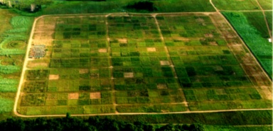
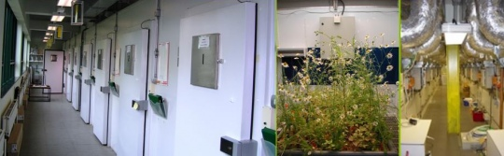
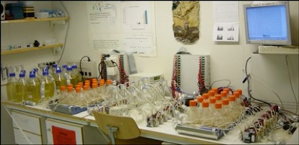
Tilman et al.
Grassland plots.
Naeem et al.
Ecotron/growth chambers
Morin, Naeem, Petchey, et al.
Protists in bottles.

Slide 10
Diversity-stability today

Slide 11
We now recognize many different definitions of stability
Table 7.1 (Loreau et al 2002)
Figure 1 (Ives and Carpenter 2007)
Table 1 (McCann 2000)

Slide 12
Current diversity stability research:
Linking theoretical and experimental definitions of stability (challenged by equilibrium vs non-equilibrium viewpoints)
Identifying mechanisms of stability (weak interactions, connectance, insurance effect, asynchrony, overyielding, etc)

Slide 13
Question 1
Are different types of stability related? (Dimensionality of stability e.g. Donahue 2013, Ives and Carpenter 2007)
e.g. Population variance (denominator of Loreau et al?) should be correlated with the eigenvalue of Jacobian (Ives et a. pg. 4 supplementary material) because rapid return toward equilibrium in deterministic systems lowers the variance of the corresponding stochastic systems. That is, environmental perturbations are more rapidly damped (Ives 1995 Ecol Mono, Ripa & Ives Theor Popn Ecol, 2003).
e.g. No expected relationship between eigenvalue of Jacobian and community CV.

Slide 14
Question 2: Exploring weak interaction mechanisms (McCann review, Ives & Carpenter 2007)
Mean interaction strength declines as species richness increases, and increases stability.
Interaction strength declines as variation of interaction strength increases (Berlow et al).
Variation of interaction strength causes increase in stability.

Slide 15
Hypothesis
As mean intx strength increases, stability increases.
Test 1: Look at tank data for support
Test 2: Generate synthetic data and see if you still get support.
If they don’t match, can we determine the difference between simulated data and real data, can we identify what is different, we can build this into our model and simulated data set, and test again.

